Slide 1

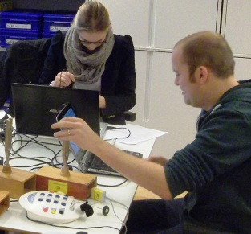
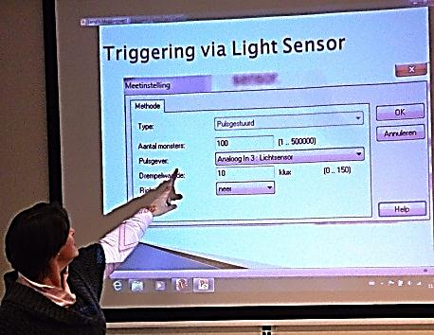
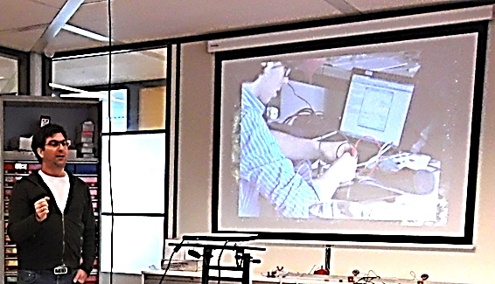
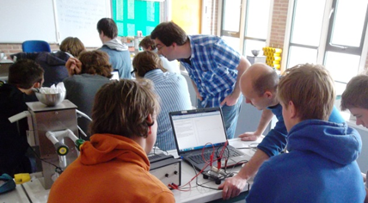

Studenten voorbereiden op toepassing van ICT in science vakken
Vincent Dorenbos (CMA), Trinh Ba Tran (VU), & Ton Ellermeijer (CMA)
conference 2013
Notes:
To achieve effectiveness of the training course on ICT integration in IBSE, the common difficulties of time constraint and heterogeneous teacher backgrounds must be taken into account.

Slide 2
Overzicht
Inleiding
Doelen cursus en opzet (Trinh)
Materialen (Vincent)
Onderzoek en eerste resultaten (Trinh)
Discussie over huidige situatie en mogelijkheden

Slide 3
Content and aims of the ICT-IBSE course
 Participants will learn to use ICT tools for physics, chemistry, or biology study.
 Participants will learn to apply these tools in classroom as part of IBSE.
Data logging: enable you to collect data via interfaces and sensors
Video measurement: enable you to make measurements on video clips
Modeling: enable you to use & create numerical models of dynamical changing systems
Notes:
Participants will
not only learn to use the Coach ICT tools to study Physics/Chemistry (domain 1 – TCK)
but also learn to apply them to teach inquiry-based Physics or Chemistry lessons (domain 2 - TPCK).
The analysis of ICT-IBSE training contents is based on Teachnological Pedagogical Content Knowledge – TPCK model (Koehler & Mishra, 2005)

Slide 4
Principles underlying the course design
Principle 1: Making proper conditions for participants to go through a complete cycle of designing, executing, and evaluating an ICT-IBSE lesson
Borghi et al. (2001, 2003) and Thurston et al. (1997)
Principle 2: Creating awareness of possibilities of the ICT tools in science teaching and motivating the participant to choose one tool to learn and apply in the classroom as part of IBSE.
Principle 3: Supporting participants’ learning through the blended setting including the course sessions and in-between tasks
Guskey (2000), Joyce & Showers (2002)
Notes:
The principles are based on theoritical and/or practical underpinings.
1. Principle 1
Borghi (2001): create the proper conditions for teachers personally to prepare work plans and teaching materials for their students
Thurston (1997): hands-on practice is more critical than theory and demonstration in a technology-based training course
IBSE vs. cookbook way of using the ICT tools
2. Principle 2
Because of 3 tools in the same computer environment – Coach, if the teacher has mastery of and experience with a tool, then she/he are motivated and able to learn and apply other ones.
3. Principle 3
Joyce & Showers (2002): the application of skills is much higher when professional development includes theory, demonstration, practice with feedback, and peer coaching with follow-up
Guskey (2000): Training sessions must be extended, appropriately spaced, or supplemented with additional follow-up activities to provide the feedback and coaching necessary for the successful implementation of new ideas.
This blended setting takes into account the shortage of time and the considerable difference among teachers about background, experience, and interest on ICT use in IBSE.

Slide 5
The course setting
Going broad on surface
Going narrow & deep to the core
Getting basic concepts & skills of the tools and possibilities of use in science teaching
Applying a particular tool to prepare an ICT-IBSE lesson
Trying the ICT-IBSE lesson out in class
& evaluating
the tryout
Pre-course preparation
1st session
3 hours
1st
in-between task
2 – 3 weeks
2nd session
3 hours
2nd
in-between task
3 – 4 weeks
3rd session
3 hours
Post-course activities
Notes:
Figure on left is the learning scenario that is related to the traing process (figure on the right)
The time for in-between tasks is broadened for participants to be able to work independently with their own competence, experience, and interest in flexible time.
The first task is about practicing a tool with supporting materials whereas the second task is about prepare the lesson plan, try it out, and evaluate the executed lesson.

Slide 6
Overview about the first ICT-IBSE course
Jan 28 – Mar 4, 2013 at CMA
12 pre-service teachers from VU and UU (8 physics, 4 chemistry).
Teaching experience
  No science teaching experience in schools. (25%)
  Teaching for less than a year in a school internship (“stage”). (33.3%)
  Teaching for less than a year as a paid teacher or partly paid/partly internship (16.7%)
  I have taught science in schools for a few years, less than 5 years (25%)
Familiarity with the ICT tools (before attending the course)
  Data logging: moderately familiar
  Video measurement and modeling: slightly familiar
Background on IBSE (before attending the course): good
Notes:
Evaluating participants’ background on IBSE is based on a few items of the ESTABLISH pre-service survey such as:
8. Please give an example of how you have used inquiry based teaching
9. Please indicate your level of agreement with each of the following statements about IBSE
10. Please indicate your level of agreement with each of the following statements about good teachers
11. Please indicate your level of agreement with each of the following statements related to your ability and motivation of IBSE

Slide 7
Moodle support
Support for participants via a Moodle environment.
http://ibse.establish-fp7.eu
Materials can be used in a course, but also for self-study.
For exchange and questions a forum is available.
Background documents describing the course and in-between tasks
Creating awareness via
  4 Introductory Powerpoints giving an overview of the tools
  Background articles from literature
  Introduction to Coach (13 minute movie)

Slide 8
Materials supporting the course
The materials for each of the tools are set-up at three levels:
  Learning the basics (overview)
  three simple Coach activities for each of the tools, to get acquainted with the tools
  Tutorial Coach activities, to master the tools. Accompanied by video tutorials (avi) and written instructions (doc)
  Subject activities for physics and chemistry (for 3 tools), exemplary activities which can serve as a source of ideas or as a resource for further development
Links to more exemplary materials

Slide 9
Session 1
Focus on ICT skills
  live overview of the Coach tools. Creating awareness of the possibilities and room for questions
  Then students select one tool and do the basic activities, next the tutorial activities (mostly in-between)
  For in-between they get information where to find support
  This course is a very condensed setting. Students prepare the Coach installation beforehand. Nothing should go wrong.
  Two groups with different levels

Slide 10
Session 2
Focus on IBSE
  Wrap up of in-between task (sometimes already a student report)
  Instruction of how to construct an ICT-IBSE lesson
  Assignments to design a lesson
  Preparation of in-between task 2 (lesson plan, and lesson execution)

Slide 11
Session 3
Focus on reporting, wrapping up and benefits
  Discussion on ICT-IBSE try-outs in groups and reporting to whole group
  Perspectives on educational benefits
    Possibilities of modeling at lower secondary (presentation)
    Possibilities for combined use of the tools (presentation)
    Interview and discussion about benefits
  Wrap-up
    Making participants aware what they did learn
    Suggestions for improving the course
    How to continue on their own?

Slide 12
Research in context of the ICT-IBSE course
Research aim:
  Developing an ICT-IBSE course based on design principles
  Evaluating effectiveness, implementation of the course
Research design
(adjusted from Knippels, 2002)
Notes:
- Explorative phase: Theory (PD, TPCK, ICT for IBSE, and development research) + Practice (ESTABLISH workshop, Coach, and pilot study at Fons Vitae)
- Cyclic phase: design the course – execute the course setting in a case study – evaluate the effectiveness and implementation – revise the course for the next case study

Slide 13
The case study – the first ICT-IBSE course
Design principles for an effective training course on ICT integration in IBSE
Elaborate
● Reflect
Revise
The course design
Goals – Contents – Learning scenario – Materials - Assessment instruments
Revise
Elaborate
 Reflect
The context-based course setting
Case study
Execute
 Reflect
Data collection and analysis
Notes:
Data analysis link to questions , ,  in the figure.
Question 1: To what extend did the course have the effects as expected? (Effectiveness)
Question 2: To what extend was the course implemented as intended? (Faithful implementation)
Question 3: (How) did the design principles work?

Slide 14
Assessment questions
To what extent are participants able to get their students involved in features of IBSE in classroom activities integrated with the ICT tool(s)?
With the experience of learning to use a particular ICT tool (e.g. data logging) in IBSE through the course, are participants motivated and able to learn a different tool (video measurement or modeling)?
How much time and how seriously do participants work in distance?
Which factors influence the participant's distance learning?
(How) are the supporting materials and the course Moodle useful to the participant's learning?
Notes:
In each research cycle, the evaluation at multiple levels is driven by the three main research questions:
Question 1: To what extend did the course have the effects as expected? (Effectiveness)
Question 2: To what extend was the course implemented as intended? (Faithful implementation)
Question 3: (How) did the design principles work?
Chỉ ra các mức độ của tính hiệu quả

Slide 15
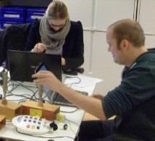
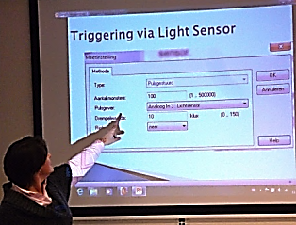
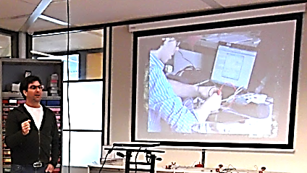
Data collection
Questionnaires
Pre-course, post-course, follow-up
Observation
Sessions and ICT-IBSE tryouts
Interviews
Participants and Teacher trainers
Documents
Coach activities, lesson plans, participants’ evaluation on the tryouts, students’ handouts
Notes:
Data collection before, during, and after the course by
Questionnaires: Pre-course, post-course, follow-up questionnaire
Observations: Sessions and ICT-IBSE tryouts
Interviews: Participants and Teacher trainers
Documents: ICT-IBSE lesson plans, participants’ self-evaluation on the tryouts, students’ handouts
Table 2 in the proposal paper (page 12, 13)

Slide 16
Participants' familiarity with the ICT tools
5 = extremely familiar
4 = very familiar
3 = moderately familiar
2 = slightly familiar
1 = not at all familiar
Notes:
Compare the familiarity before and after the course
The rating scale is noted on the left of the bar chart.
Nói nguồn gốc số liệu này ở đâu – triangulation (at least 2 resource)

Slide 17
Participants' ICT-IBSE tryouts
Participant | Tryout time | Type of tryout | Type of IBSE
Participant 1 | April 2 - 12 | School project | Guided inquiry
Participant 2 | April 8 | Small group | Guided inquiry
Participant 3 | March 7 | A class | Interactive demonstration
Participant 4 |  | A class | Guided inquiry
Participant 5 | March 13 | A class | Interactive demonstration
Participant 6 | February 26 | A class | Guided inquiry
Participant 7 | April 5 | A class | Interactive demonstration
Participant 8 | March 12 | A class | Guided inquiry
Participant 9 | March 5 | Small group | Guided inquiry
Participant 10 | April 5 | A class | Interactive demonstration
Participant 11 | March 1 | School project | Open inquiry
Participant 12 | April 24 | Small group | Guided inquiry
Notes:
Summary:
- 11/12 could accomplish a full cycle of designing, executing, and evaluating a ICT-IBSE lesson. Freark’s school does not have Coach equipment.
Tryouts were at different time because they depended on school schedule, curriculum, teachers’ individual agenda
3 types of tryouts: school projects (2), whole class (6), small group (3)
3 types of IBSE: Interactive demonstration, guided inquiry, open inquiry
Some notes: Sander, Marco, Bas

Slide 18
How confident the participants are in learning and using the other tool(s) which they did not study during the course
Notes:
When participants spend most of the time to work on their own and gain experience with a tool, they will be motivated and confident to learn other tools. A participant, who ask teacher trainers many times, is not confident at all.

Slide 19
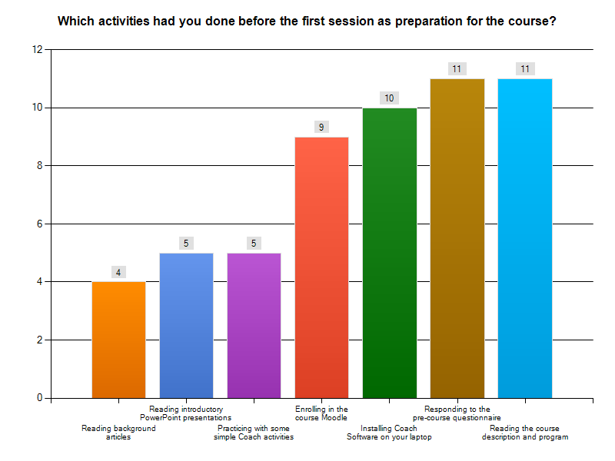
How much time participants worked in distance
Pre-course: 2 hours
The first task: 3,5 hours
The second task: 7 hours
The in-distance time: 12,5 hours
The session time: 9 hours

Slide 20
Which factors influence the participant's distance learning?
Factors | Rating
Your awareness of benefits of performing the tasks | 3.83
Sufficient learning conditions such as time, equipment, and school supports | 3.67
Timely helps from teacher trainers when you encounter difficulties, and then ask them | 3.5
Emails somehow reminding you about the task | 3.42
The requirement that you must present your task results in the meetings | 3.33
Obvious task descriptions including clear deadline | 3.18
The convenient online platform where you can find solutions for your problems by yourself | 2.5
1 = not at all influential, 2 = slightly influential,
3 = moderately influential, 4 = very influential,
5 = extremely influential,

Slide 21
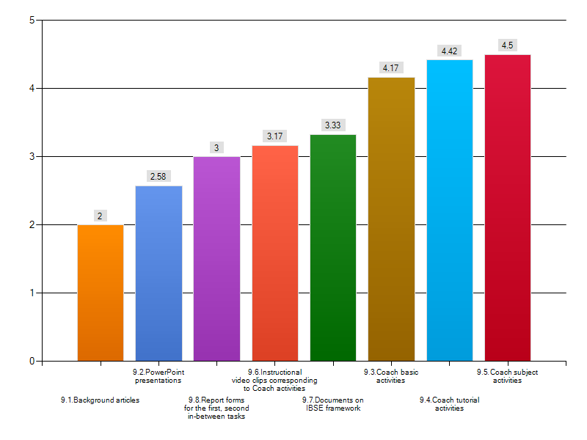
(How) are the supporting materials useful to the participant's learning?
1 = not at all useful, 2 = slightly useful, 3 = moderately useful,
4 = very useful, 5 = extremely useful,

Slide 22
Participants’ feedbacks
“The blended setting offers you the opportunity to work in your own time”, Amy
“I prefer the longer timeframe it gives you time to work at home and make a real product instead of rushing through something. I just wish we had more feedback for the personal project (3rd session)”, Matt
“With the blended setting, you have more time to actually develop and carry out a lesson plan.”, Sander
“I hope my future school will have sufficient ICT opportunities to use Coach in my classes”, Amy
“I will try to do at least 1 or 2 graded, official coach labs per teaching term, and use coach more frequently for demonstrations and tiny activities.”, Matt
“I will use more ICT from now on. Internet shall be my guide”, Marco

Slide 23
Discussion points
Hoe wordt op dit moment aandacht besteed in de opleiding aan ICT?
Vragen en reacties op de voorgestelde opzet.
Mogelijkheden om van de ontwikkelde cursus gebruik te maken:
  zelf gebruiken;
  studenten van verschillende opleidingen combineren, evt. Met een afsluitende conferentie.
Belangstelling voor een train-the-trainers cursus?

